Slide 1
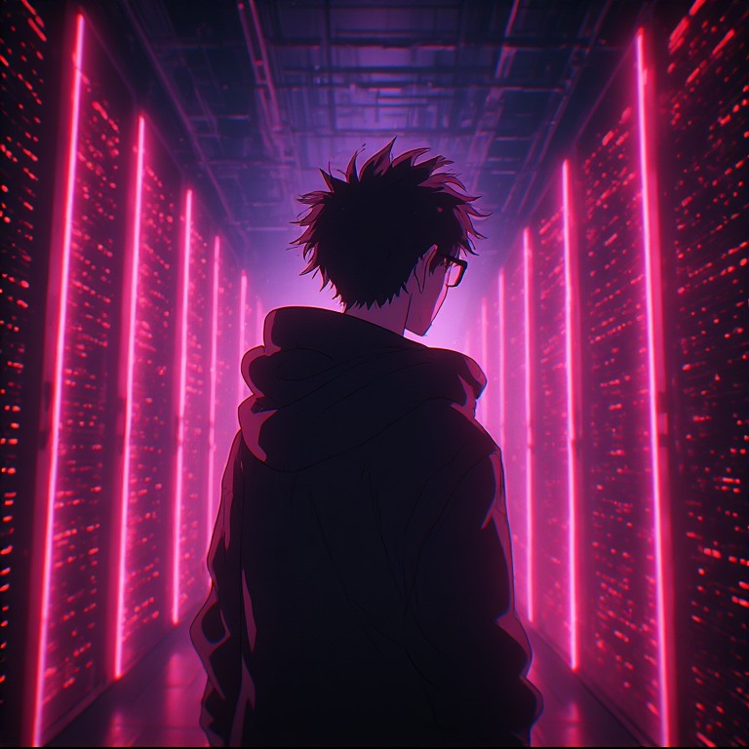
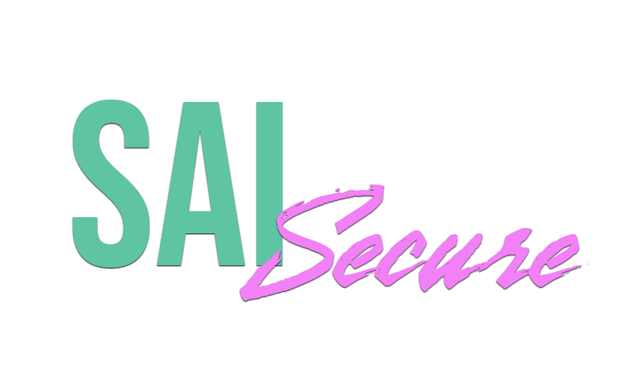
Slide title
Threats? Hunted.
Replace body copy.
Keep screenshots, charts, and hero art aligned with Brand Guide dashboard and hero rules.
Infected Industries • Confidential • 2026

Slide 2
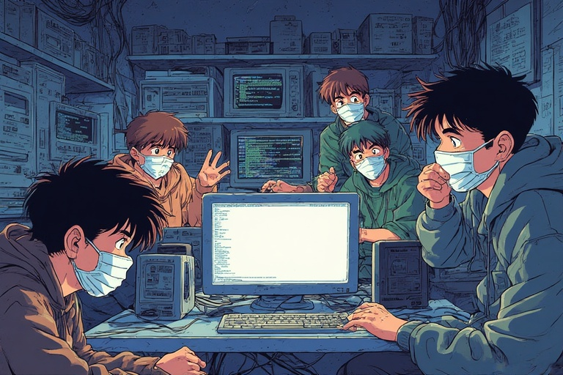


Slide title
03 / 17
The Problem
Team time constraints
AI evolution & speed
The EDR gap
Replace body copy.
Keep screenshots, charts, and hero art aligned with Brand Guide dashboard and hero rules.
Threat actors use AI to pivot faster, refine failed attacks, and scale ransomware-as-a-service — lowering the bar for sophisticated campaigns.
Leading endpoint platforms meet compliance needs but often silo management, deprioritize core functionality, and leave customers with limited customization and missed IOCs.
Infected Industries • Confidential • 2026

Slide 3

Slide title
05 / 17
Per-entity output
Risk Score
01
Custom research toolkit
Calibrated 0–10 using a custom logic formula.
Submit entities manually or let automation queue them for you — then SAI Triage draws on proprietary research tools built by the Infected Industries team, querying enrichment sources, reputation data, and contextual intelligence as part of every review.
Verdict
Sai reviews incoming IOC entities using analyst created playbooks and workflows. He uses this logic to provide a verdict.
02
News & article intelligence
Reviews incoming news and scraped articles for threat actors, ransomware groups, and malware families — links actors, pulls IOCs into the entity base, and can respond in Slack or private messages.
Threat Actors
Linked new entities to existing threat actor or ransomware group profiles for reporting and tracking.
03
Attack path & risk scoring
Threat Report
Attack-path scoping links threat actors across entities. Organizations control how risk scoring works — SAI adjusts to your environment and explains remediation recommendations.
As true positive entities are identified, Sai updates threat actor reports, Yara rules, Sigma rules and custom alerting.
04
Threat actor linking & team reports
Custom Detections
When attribution is possible, SAI Triage connects reviewed entities to existing Threat Actor profiles — then produces structured threat reports your team can share, review, and act on together.
Users can tell Sai what to research using custom detections. Monitor breaches or threat actors and he will focus on them!
SAI Triage
Research trail
Replace body copy.
Keep screenshots, charts, and hero art aligned with Brand Guide dashboard and hero rules.
As Sai triages entities, he provides updates and insights by using comments and logging.
05
Custom detections
Teams can author custom detections for SAI Triage — defining what to watch for and automatically linking matched articles, entities, threat actors, and related intelligence as findings surface.
30,000+
IP Addresses
File Hashes
True positive IOCs identified that others missed.
Domains
Processes
85%
Custom Detections
Manual Entry
not identified by traditional endpoint platforms.
Profiles often days ahead of public intel.
Infected Industries • Confidential • 2026

Slide 4
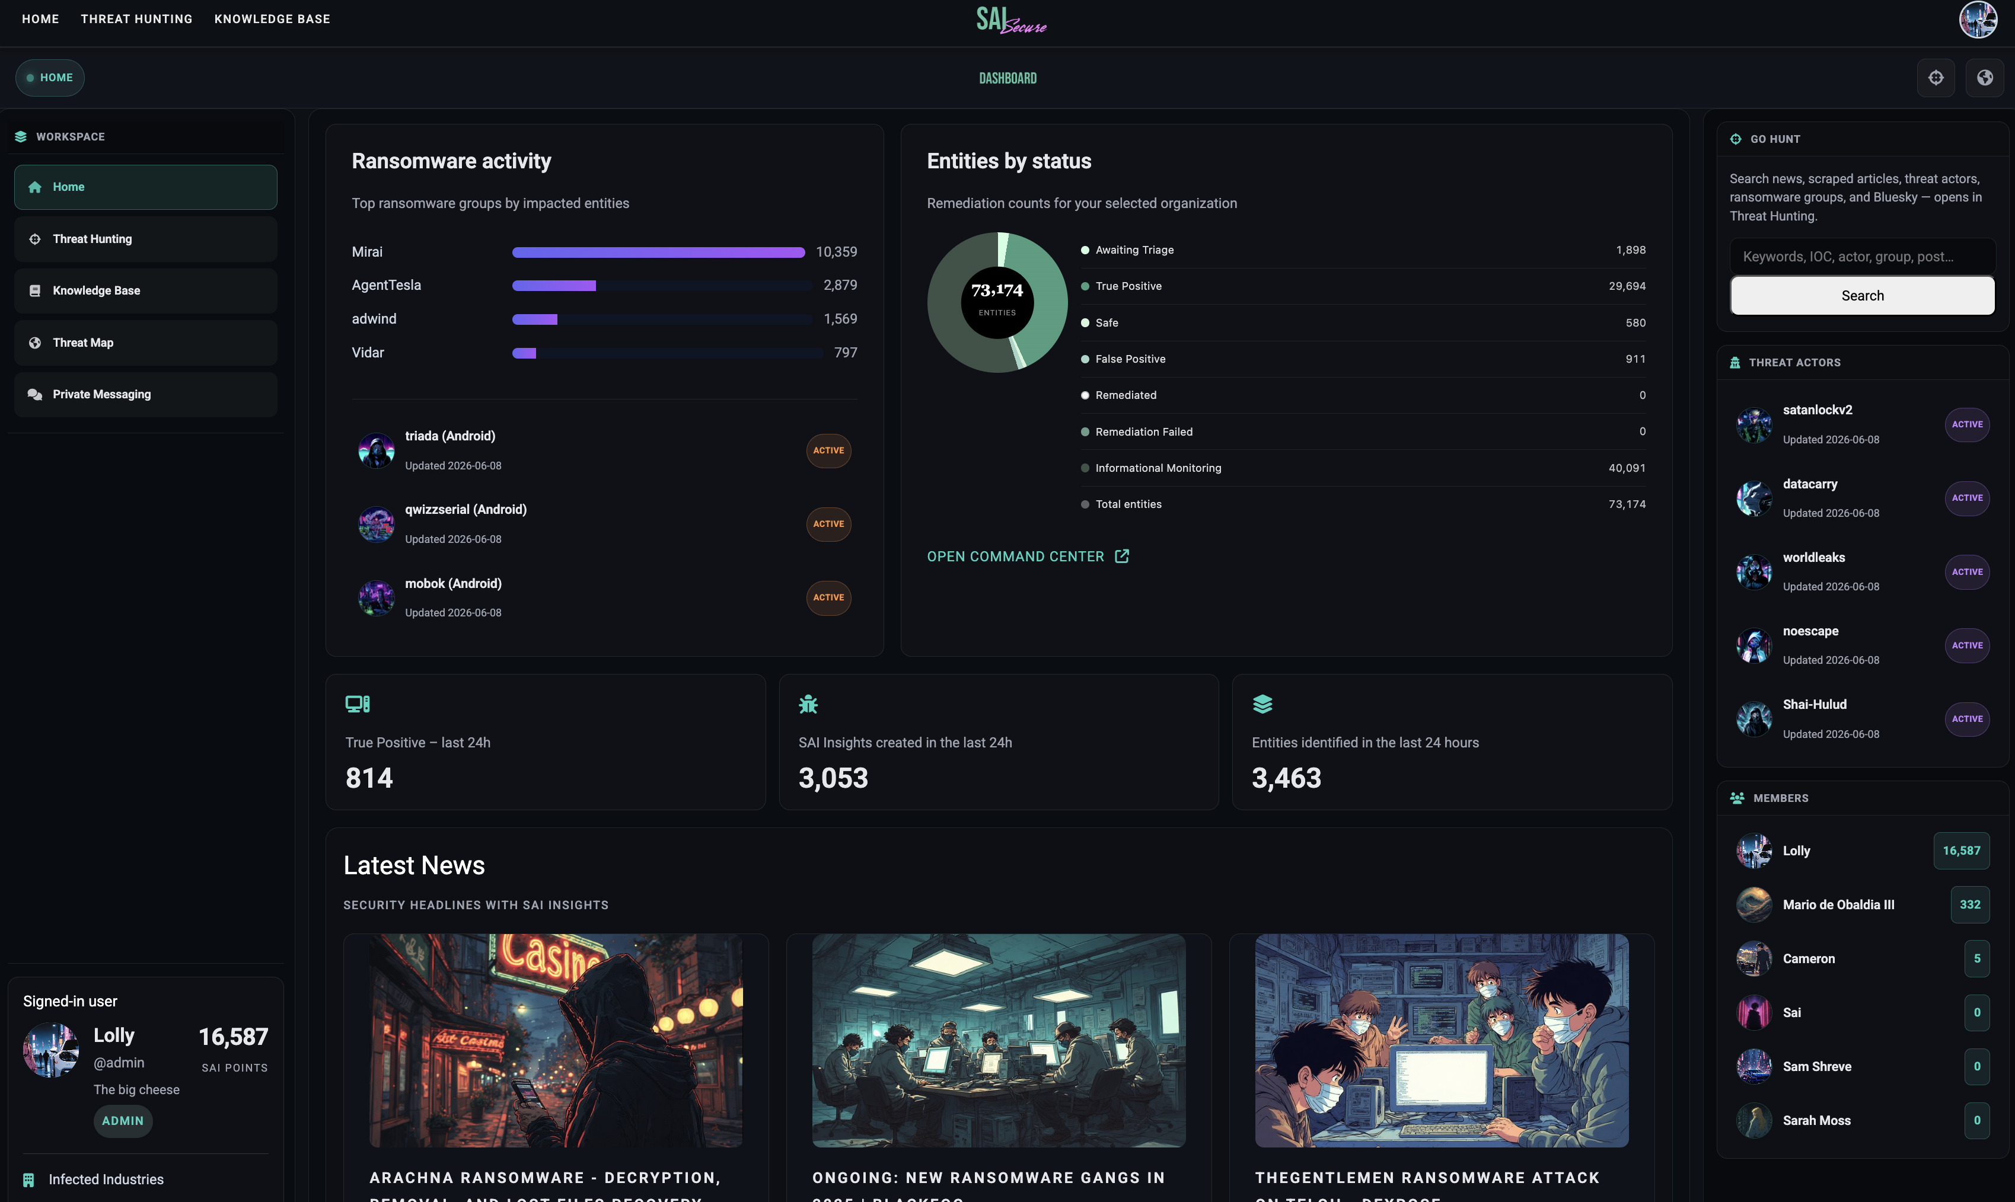
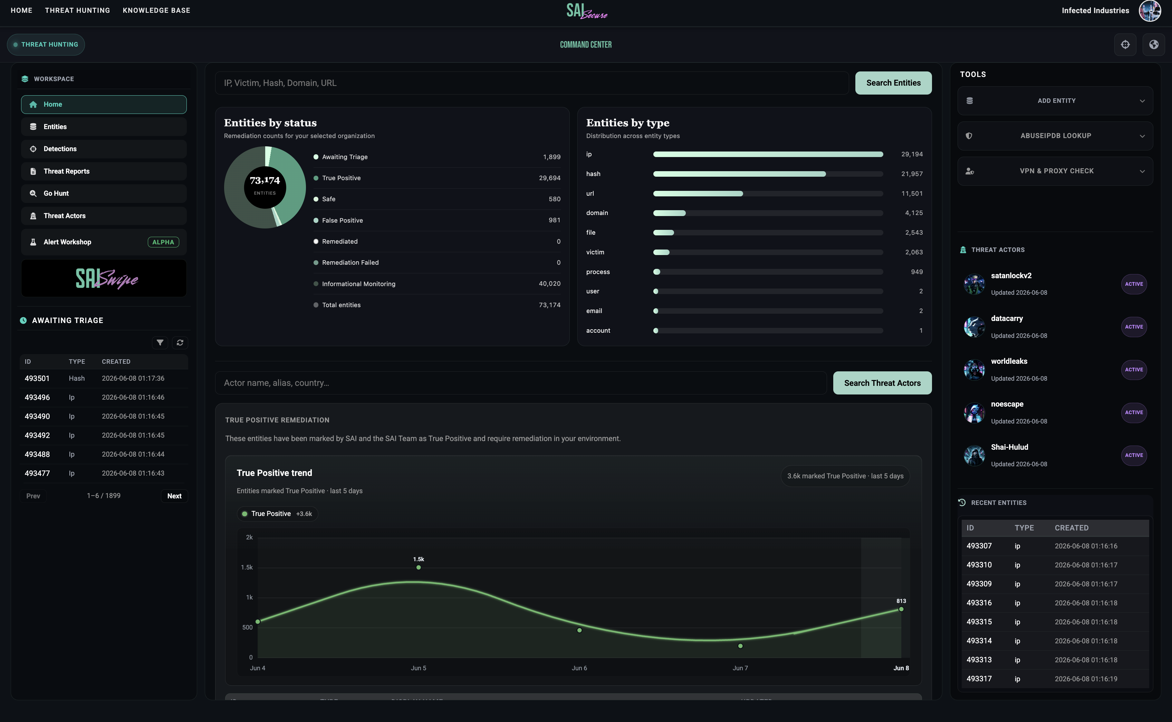
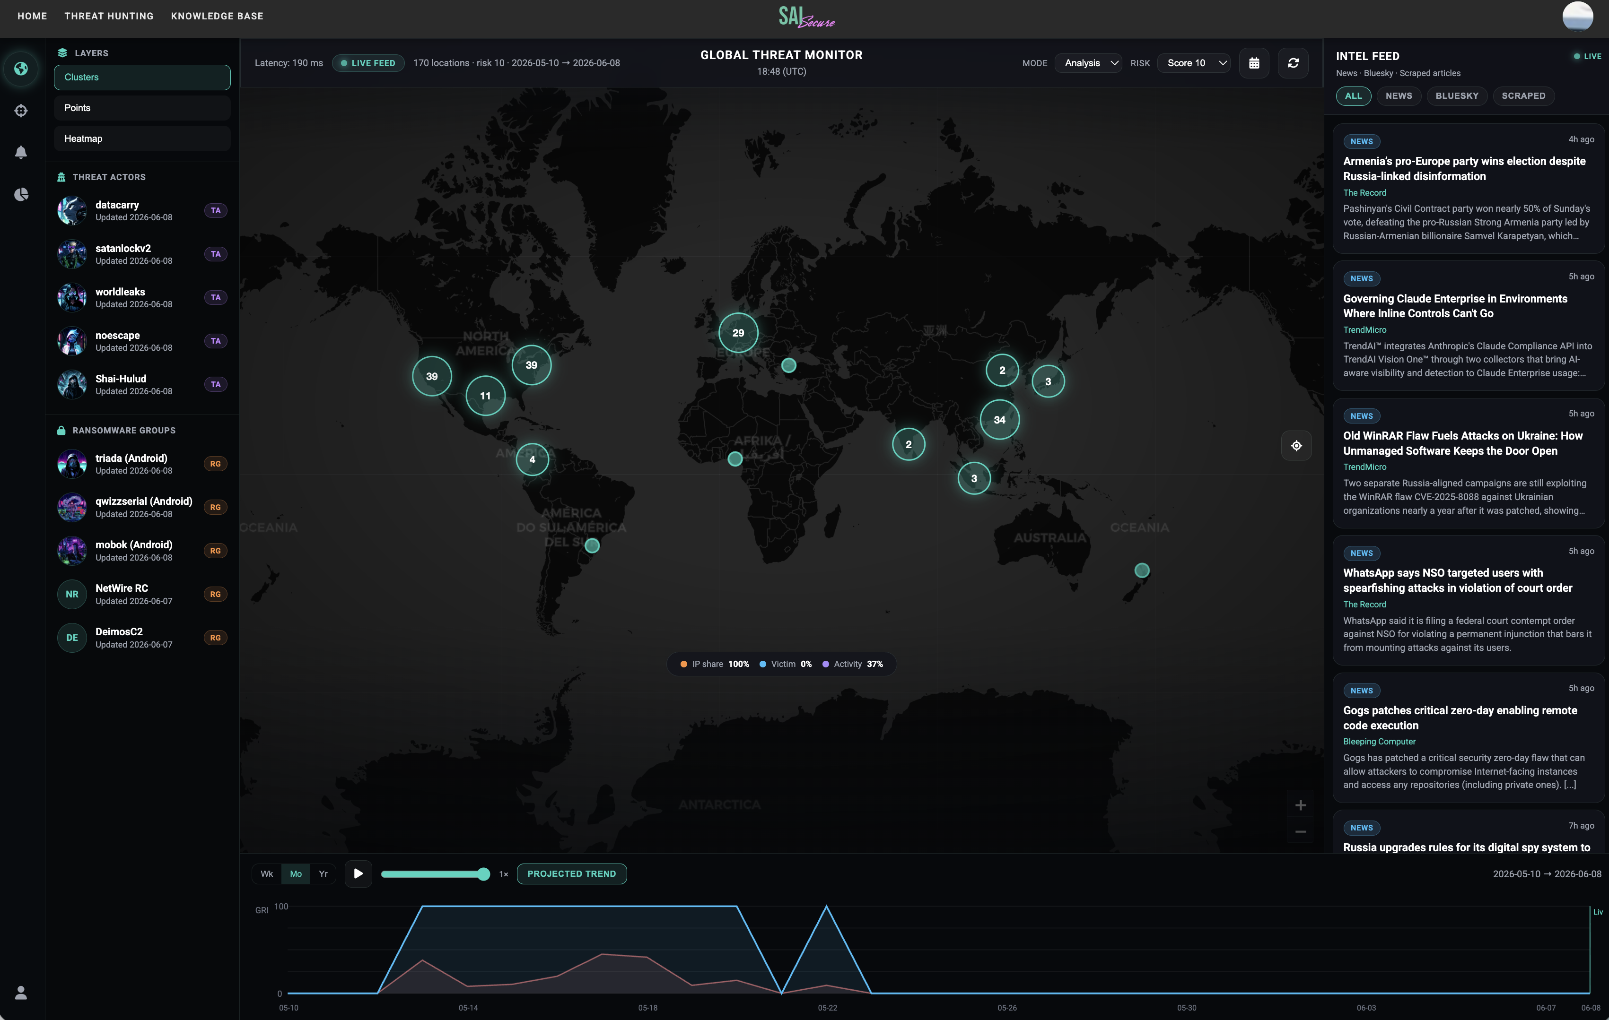
Slide title
07 / 17
Platform Experiences
Replace body copy.
Keep screenshots, charts, and hero art aligned with Brand Guide dashboard and hero rules.
1
2
3
Live Analytics
Command Center
Threat Map
Ransomware activity — Real-time tracking of active campaigns, victim disclosures, and group-level trends.
Latest news with SAI’s take — Curated headlines with SAI-enriched analysis, focused on actionable signal.
Threat actor profiles — Continuously updated adversary profiles with aliases, TTPs, linked entities, and attribution context.
Unified entity queue — Domains, hashes, IPs, senders, and recent victims in one workspace, manual or automated.
Evidence & context — Full research trail, enrichment sources, and supporting intelligence for every entity.
Insights & verdict — Risk scoring, classification, threat actor links, and written rationale from SAI Triage.
Optional remediation — True positives push to CrowdStrike, Abnormal, or Intezer —analyst-initiated or by automation.
Live geographic view — High-risk IPs and active threat activity on a global map.
Risk score 10 entities — Items that hit a risk score of 10 plot on the map in real time as SAI Triage completes review.
Global risk signals — Hotspots and activity update continuously as new intelligence surfaces.
Live news & article feed — Security news and scraped articles stream in real time alongside the map for correlation with geographic risk
Infected Industries • Confidential • 2026

Slide 5
Slide title
12 / 17
How We Compare
Replace body copy.
Keep screenshots, charts, and hero art aligned with Brand Guide dashboard and hero rules.
Capability | SAI | Competitor
Detection rule authoring (SAI Code) | YARA, Sigma, SIEM/XDR | Manual / separate tools
Fine-tuned entity triage (SAI Triage) | IP, hash, domain, process | Generic enrichment
Multi-model AI investigation agents | Orchestrated | Single-model / manual
Analyst-built guardrails & prompt engineering | Built-in | —
AI Threat Hunting Agent & unified command workspace | Core platform | Not primary focus
Adversary HUMINT & underground intelligence | Curated feeds | Core strength
Dark web query intelligence | Query-driven | Analyst-led feeds
Entity triage queues & operational workflows | Built-in | Intelligence-led
Custom SAI Triage detections | User-defined linking | —
Full API & SAI Tools automation | Programmatic access | Limited / UI-only
True Positive push to EDR / XDR | CrowdStrike, Abnormal, Intezer | Manual export
Mobile triage (SAI Swipe) | Included | —
Attack surface & third-party exposure | Limited | Exposure platform
Behavioral threat hunting | AI-assisted | Guided hunt packs
Knowledge base & analyst runbooks | Built-in | Finished intel reports
Infected Industries • Confidential • 2026

Slide 6
Slide title
17 / 17
Questions?
Infected Industries • Confidential • 2026

